Slide 1
Atliq Hospitality Analysis
By Akash Redkar

Slide 2
INTRODUCTION
Atliq Grands, a prominent player in the hospitality sector, confronts challenges in sustaining market share and revenue amidst intense industry competition. To counter these challenges, the company aims to harness the power of data analytics for strategic insights.

Slide 3
OBJECTIVE
Market Share Revitalization: Employ data analytics to reclaim lost market share in the luxury/business hotels segment.
Revenue Enhancement: Identify avenues for optimizing revenue across all properties.
Operational Streamlining: Improve operational efficiency and elevate guest experiences through data-driven insights.
Informed Decision-Making: Enable informed and strategic decision-making processes supported by data analytics.

Slide 4
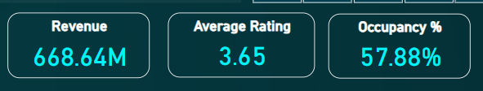
Main KPI’s
Total Revenue - Evaluate the overall Revenue generated to understand business performance.
Average Rating - Assess the mean customer rating to ensure consistent high-quality service.
Occupancy % - Track room occupancy rates to optimize revenue and resource utilization.

Slide 5
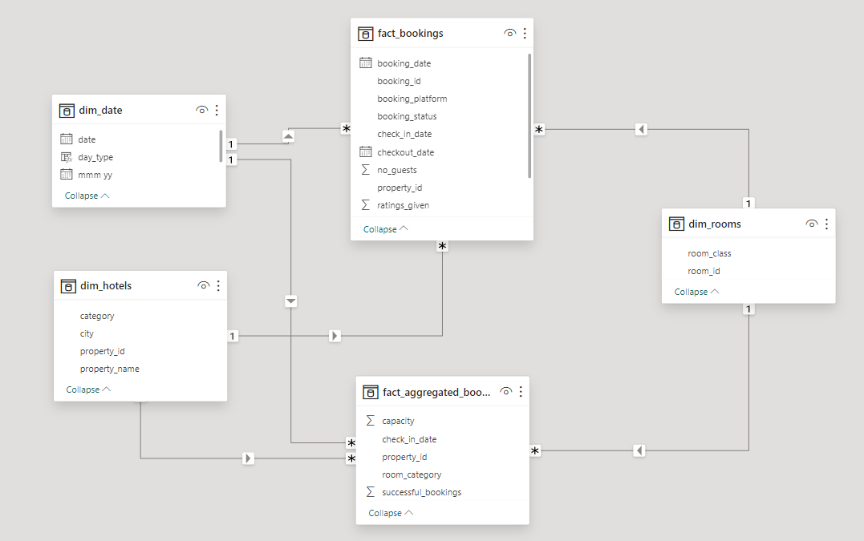
Model View

Slide 6
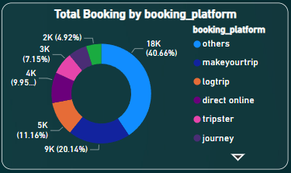
Booking Distribution by Platform
The bar graph shows the total booking by booking platform, with six platforms explicitly mentioned: 2K, 3K, 4K, 5K, 9K, and 18K. The "others" category includes bookings made through various other platforms, which together account for 40.66% of the total bookings.

Slide 7
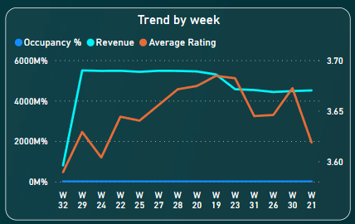
Weekly Performance Metrics
The graph shows three trends over time, with the x-axis representing the week and the y-axis representing the value of Occupancy % and Revenue and Secondary y-axis representing value of Average Rating.

Slide 8
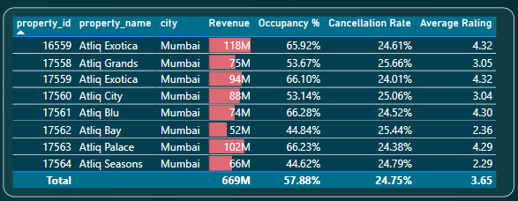
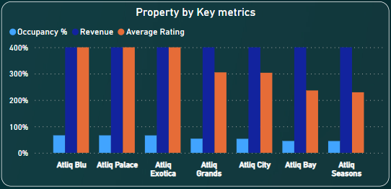
Property Performance Overview
This table shows the revenue, occupancy percentage, cancellation rate, and average rating for six properties with the prefix "Atliq" in Mumbai.
This information can be used to compare the performance of different properties and make data-driven decisions for the business.

Slide 9
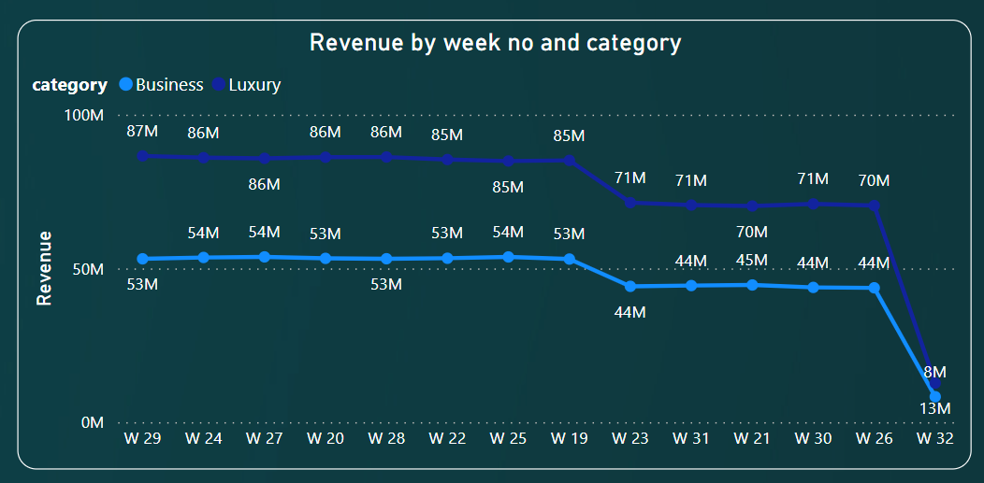
Revenue Trends by Week and Category
The line chart shows the weekly revenue for two categories of properties: Business and Luxury Generally it is a Tooltip which i used to display the Revenue by week and category.

Slide 10
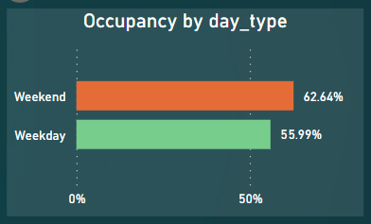
Occupancy Trends by Day Type
This Bar graph shows the occupancy rate for two types of days: weekend and weekday. The occupancy rate for weekends is 90%, while the occupancy rate for weekdays is 50%. This information suggests that there is a higher demand for the product or service on weekends compared to weekdays

Slide 11
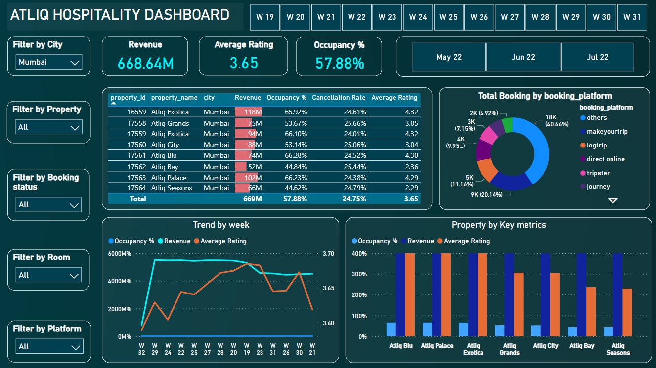
Final Dashboard Overview

Slide 12
Dashboard Tip
Note : Here I have used Tooltips for All three KPI’s, To View the Tooltip Graph Just Hover the mouse towards the card and place it on the KPI’s Card.

Slide 13
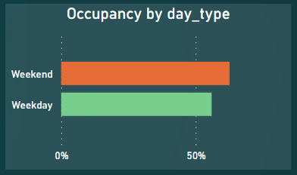
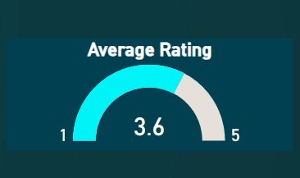
Dashboard Tooltips
Note : Here I have used Tooltips for All three KPI’s, To View the Tooltip Graph Just Hover the mouse towards the cards(Revenue, Occupancy % and Avg Rating) and place it on the KPI’s Card.

Slide 14
THANK YOU

